Slide 1
Standards for Application Developers

Slide 2
Why Application development standards?
To ensure uniform, consistent, high-quality software solutions.
80% lifetime cost of software goes to maintenance.
hardly any software is maintained by the original author for its complete life cycle.
standards help to improve the readability of the software, allowing developers to understand new code more quickly and thoroughly.
For shipping the code as a product it should be well packaged and should meet industry standards

Slide 3
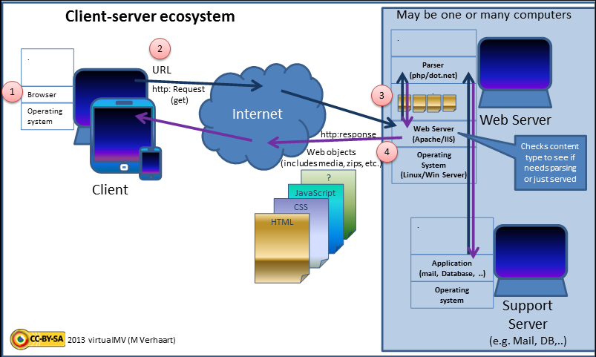

Slide 4
Standards
Browsers (Ajax)
Data (XML, JSON)
Solution Stacks (LAMP and LAPP)

Slide 5

Standards for Application Developers(Cont’d)
Browsers (Ajax)
Its predecessor AJAX (Asynchronous JavaScript and XML).
web development techniques used to create interactive web applications
Update a web page without reloading the page
Request data from a server - after the page has loaded
Receive data from a server - after the page has loaded
Send data to a server - in the background
A web application can request only the content that needs to be updated.
This greatly reduces networking bandwidth usage and page load times.
Use in interactive animation on web pages.
ICEfaces Ajax Application Framework

Slide 6

Standards for Application Developers(Cont’d)
Data (XML, JSON)
XML(Extensible Markup Language)
  sharing of structured data
  Usually combination with other standards.
  Define the content of a document separately.
JSON(JavaScript Object Notation)
  A lightweight computer data interchange format
  Is specified in Internet Engineering
  Request for Comment (RFC)
  Independent data format

Slide 7

Standards for Application Developers(Cont’d)
Solution Stacks (LAMP and LAPP)
LAMP
  The acronym Linux,Apache,MySQL, and PHP (or Perl or Python)
  Open source nature, low cost, and the wide distribution of its components
  Used to
    Run dynamic web sites and servers.
    Development and deployment of high-performance web applications.
    Define a web server infrastructure.
    Creating a programming environment for developing software.
LAPP
    It is more powerful than LAMP stack

Slide 8
The purpose :
Security standards define the processes, procedures, and practices necessary for implementing a security program.
SAML
OAuth
OpenID
SSL/TLS

Slide 9
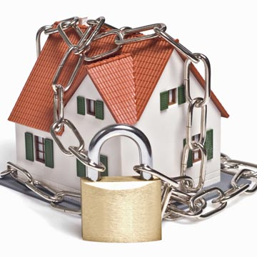
Standards for Security(Cont’d)
SAML
  Standard for communicating authentication, authorization, and attribute information among online partners.
  It allows businesses to securely send assertions between partners.
  SAML protocol refers to what is transmitted, not how it is transmitted.
  Three types of statements are provided by SAML: authentication statements, attribute statements, and authorization decision statements

Slide 10

Standards for Security(Cont’d)
OAuth(Open Authentication)
  OAuth is a method for publishing and interacting with protected data.
  For developers, OAuth provides users access to their data .
  OAuth allows users to grant access to their.
  OAuth by itself provides no privacy at all and depends on other protocols such as SSL .

Slide 11
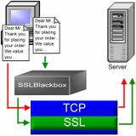

Standards for Security(Cont’d)
OpenID
  OpenID is an open, decentralized standard for user authentication.
  And allows users to log on to many services using the same digital identity.
  It is a single-sign-on (SSO) method of access control.
SSL/TLS
  TLS or its predecessor SSL
  To provide security and data integrity for communications.
  To prevent eavesdropping, tampering, and message forgery.

